Slide 1
IoT Based Environmental Monitoring System
TEAM:Creative Spark
I.SANDHIYA J
II.SHABHARHI SHREE J
III.SRIMATHI R
IV.SANTHIYA R

Slide 2
ABSTRACT:
The IoT Based Environmental Monitoring System is designed to monitor temperature and humidity remotely. A DHT11 sensor measures the environmental parameters, and the STM32 microcontroller receives and processes the sensor data using DMA.
The processed data is transmitted through UART Serial communication to the ESP8266 Wi-Fi module. The ESP8266 sends the data to the ThingSpeak cloud platform, enabling real-time remote monitoring of environmental conditions.

Slide 3
INTRODUCTION
Environmental monitoring is important for measuring parameters such as temperature and humidity. Traditional monitoring methods may require manual observation and cannot provide continuous remote monitoring.
In this project, a DHT11 sensor measures temperature and humidity. The STM32 microcontroller receives and processes the sensor data using DMA. The processed data is transferred through UART Serial communication to the ESP8266 Wi-Fi module. Finally, ESP8266 uploads the data to the ThingSpeak cloud platform for remote monitoring.

Slide 4
PROBLEM STATEMENT
Manual monitoring of temperature and humidity requires continuous human effort.
Conventional monitoring methods do not provide real-time remote access.
Continuous collection and transmission of sensor data can be difficult.
A reliable system is needed to automatically collect, process, and monitor environmental data remotely.

Slide 5
PROPOSED SOLUTION
Use DHT11 for temperature and humidity measurement.
Use STM32 with DMA to process sensor data.
Use UART Serial communication to transfer data to ESP8266.
Use ESP8266 Wi-Fi to upload data to ThingSpeak Cloud.

Slide 6
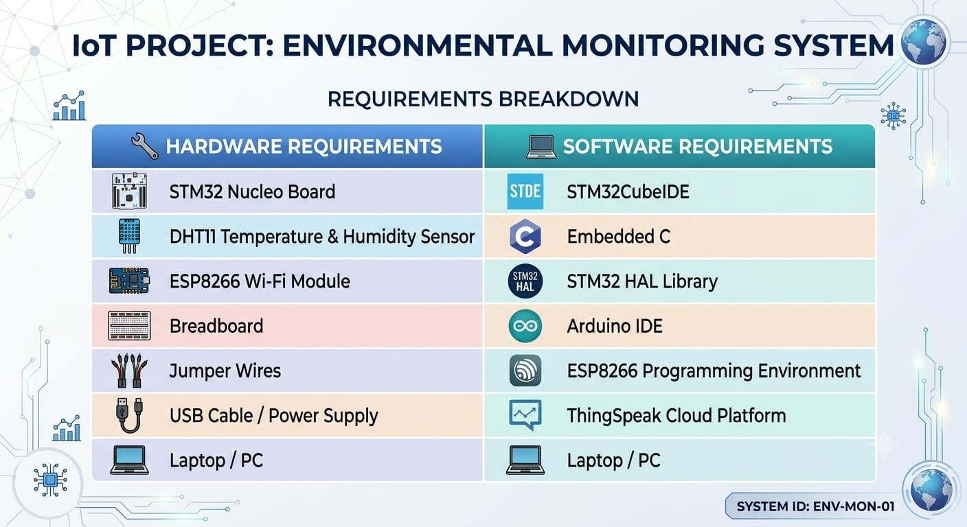
HARDWARE & SOFTWARE REQUIREMENTS

Slide 7
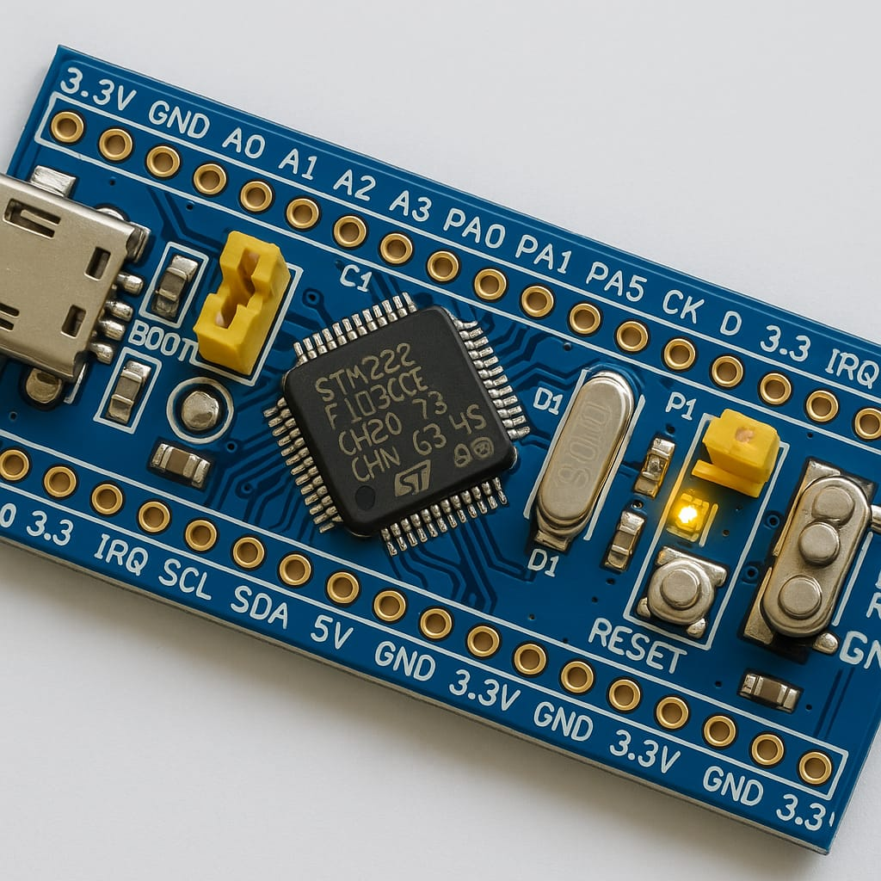
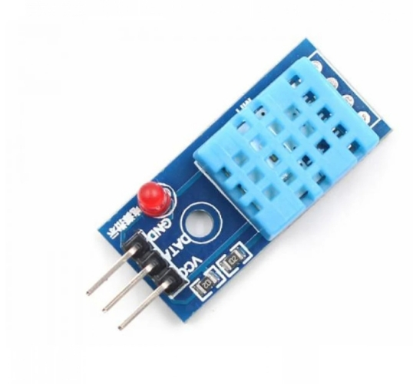
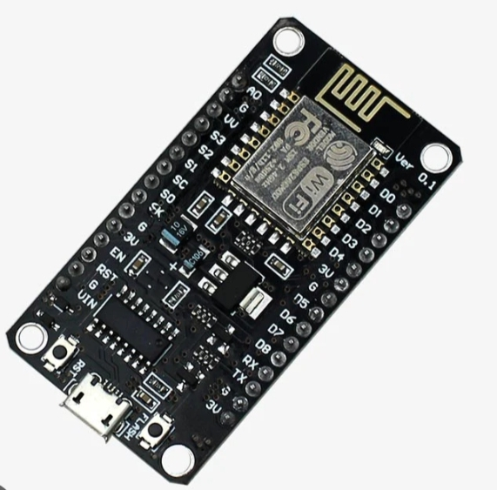
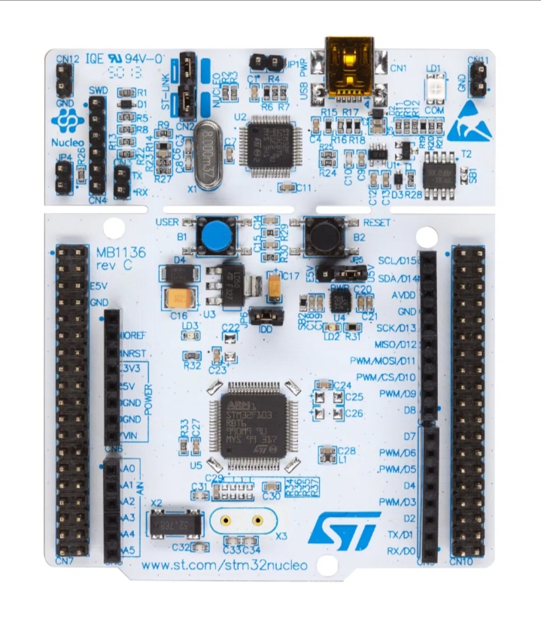
BLOCK DIAGRAM
DHT11 Sensor
↓
STM32 Microcontroller
↓
ESP8266 Wi-Fi
↓
Internet
↓
ThingSpeak Cloud
↓
Mobile / Laptop

Slide 8
WORKING
The DHT11 sensor measures the temperature and humidity of the environment and sends the sensor data to the STM32 Nucleo board. The STM32 receives and processes the data using DMA.
The processed data is then transmitted to the ESP8266 Wi-Fi module through UART Serial communication. The ESP8266 connects to the Internet and uploads the temperature and humidity data to the ThingSpeak cloud platform. The user can then monitor the environmental data remotely through the ThingSpeak dashboard.

Slide 9
LIMITATIONS
DHT11 has limited measurement accuracy.
Stable Wi-Fi connection is required.
ESP8266 depends on Internet availability.
Suitable mainly for basic environmental monitoring.
Sensor range and response time are limited.

Slide 10
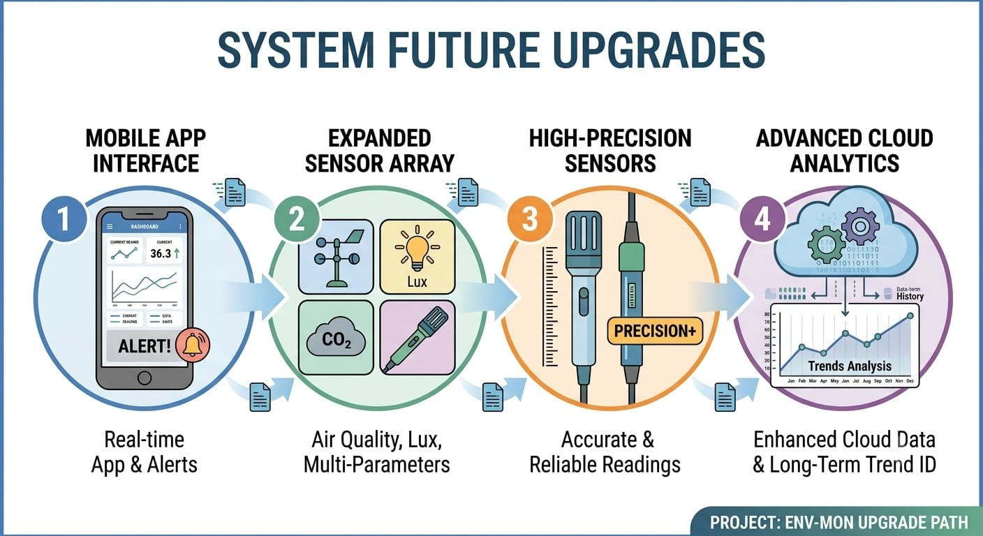
FUTURE UPGRADES
The system can be further improved by developing a dedicated mobile application for real-time monitoring and alert notifications.
Additional sensors such as air-quality, light, and pressure sensors can be integrated to monitor more environmental parameters.
More accurate sensors can be used to improve measurement reliability. Cloud-based data storage and analysis can also be enhanced to maintain long-term environmental records and identify changes or trends.

Slide 11
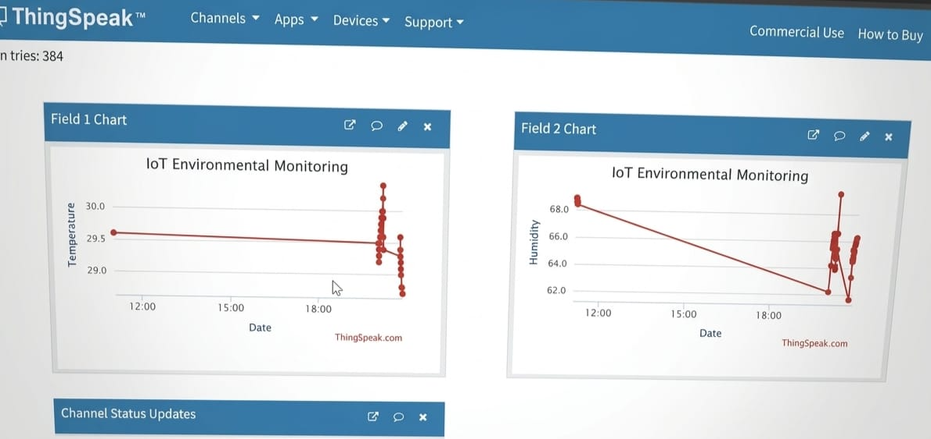
CONCLUSION
The proposed IoT based environmental monitoring system successfully monitors temperature and humidity in real time. DHT11 collects the environmental data, and STM32 processes the data using DMA.
The data is transferred through UART to ESP8266 and uploaded to ThingSpeak through Wi-Fi. This system provides a simple and effective solution for remote environmental monitoring and can be enhanced with additional sensors and IoT features in the future.

